Slide 1
A HSA Full System Simulator – Translator
HSA translator based on LLVM

Slide 2
LLVM
Low Level Virtual Machine
© Copyright Khronos Group, 2013

Slide 3
What is LLVM?
LLVM－Low-Level Virtual Machine
  A compiler framework that aims to make lifelong program analysis and transformation available for arbitrary software, and in a manner that is transparent to programmers.

Slide 4
Introduction to Classical Compiler Design
Three major components of a Three-Phase Compiler
Source
Code
Frontend
Optimizer
Backend
Machine
Code
The frontend parses source code, checking it for errors, and builds a language-specific Abstract Syntax Tree (AST) to represent the input code.
The optimizer improves the code’s running time.
The backend (also known as the code generator) then maps the code onto the target instruction set.

Slide 5
Common Example
Example of a Three-Phase Compiler
X86
Backend
C
Frontend
X86
C
Fortran
Frontend
Common
Optimizer
ARM
Backend
Fortran
ARM
HSAIL
HSA
Frontend
GPU
Backend
GPU
If the compiler uses a common code representation in its optimizer, then a frontend can be written for any language that can compile to it, and a backend can be written for any target that can compile from it.

Slide 6
LLVM Example
LLVM Example of a Three-Phase Compiler
LLVM
X86
Backend
Clang C/C++/ObjC
Frontend
X86
C
llvm-gcc
Frontend
LLVM
Optimizer
LLVM
ARM
Backend
Fortran
ARM
HSA Translator
Frontend
LLVM IR
LLVM IR
HSAIL
LLVM
GPU
Backend
GPU
The Clang Compiler is an open-source compiler for the C family of programming languages. Clang builds on the LLVM optimizer and code generator, allowing it to provide high-quality optimization and code generation support for many targets.

Slide 7
LLVM Example
LLVM Example of a Three-Phase Compiler
LLVM
X86
Backend
Clang C/C++/ObjC
Frontend
X86
C
llvm-gcc
Frontend
LLVM
Optimizer
LLVM
ARM
Backend
Fortran
ARM
HSA Translator
Frontend
LLVM IR
LLVM IR
HSAIL
LLVM
GPU
Backend
GPU
The llvm-gcc Compiler is a gcc-compatible compiler for better and faster optimization.

Slide 8
LLVM Example
LLVM Example of a Three-Phase Compiler
LLVM
X86
Backend
Clang C/C++/ObjC
Frontend
X86
C
llvm-gcc
Frontend
LLVM
Optimizer
LLVM
ARM
Backend
Fortran
ARM
HSA Translator
Frontend
LLVM IR
LLVM IR
HSAIL
LLVM
GPU
Backend
GPU
The HSA Translator frontend is a compiler frontend for translating HSAIL to LLVM IR.

Slide 9
LLVM Example
LLVM Example of a Three-Phase Compiler
LLVM
X86
Backend
Clang C/C++/ObjC
Frontend
X86
C
llvm-gcc
Frontend
LLVM
Optimizer
LLVM
ARM
Backend
Fortran
ARM
HSA Translator
Frontend
LLVM IR
LLVM IR
HSAIL
LLVM
GPU
Backend
GPU
In an LLVM-based compiler, a frontend is responsible for parsing, validating and diagnosing errors in the input code, then translating the parsed code into LLVM IR

Slide 10
LLVM Example
LLVM Example of a Three-Phase Compiler
LLVM
X86
Backend
Clang C/C++/ObjC
Frontend
X86
C
llvm-gcc
Frontend
LLVM
Optimizer
LLVM
ARM
Backend
Fortran
ARM
HSA Translator
Frontend
LLVM IR
LLVM IR
HSAIL
LLVM
GPU
Backend
GPU
The LLVM backend(code generator) is responsible for transforming LLVM IR into target specific machine code.

Slide 11
LLVM IR
LLVM IR
  LLVM Intermediate Representation
unsigned sub1(unsigned a, unsigned b) {
return a-b;
}
C code
define i32 @sub1(i32 %a, i32 %b) {
entry:
%tmp1 = sub i32 %a, %b
ret i32 %tmp1
}
LLVM IR(Bitcode)
LLVM IR is the form it uses to represent code in the compiler.

Slide 12
SPIR
Standard Portable Intermediate Representation
© Copyright Khronos Group, 2013

Slide 13
What is SPIR ?
Standard Portable Intermediate Representation
Portable non-source representation for OpenCL 1.2 device side code
SPIR is a mapping from the OpenCL C programming language into LLVM IR
OpenCL 1.2 Extension standardizes an API for reading SPIR files, cl_khr_spir
SPIR 1.2 public review draft defines the IR and clarifies changes to support SPIR with LLVM
© Copyright Khronos Group, 2013

Slide 14
OpenCL C mapping to SPIR
OpenCL C Type | LLVM Type
bool | i1
char | i8
unsigned char, uchar | i8
short | i16
unsigned short, ushort | i16
int | i32
unsigned int, uint | i32
long | i64
unsigned long, ulong | i64
float | float
double | double
half | hald
void | void
OpenCL C Type | LLVM Type
charn | < n x i8 >
ucharn | < n x i8 >
shortn | < n x i16 >
ushortn | < n x i16 >
intn | < n x i32 >
uintn | < n x i32 >
longn | < n x i64 >
ulongn | < n x i64 >
unsigned long, ulong | i64
halfn | < n x half >
floatn | floatn
doublen | < n x double >
Mapping for built-in scalar data types
Mapping for built-in vector types

Slide 15
Why use SPIR ?
Without SPIR:
  Some vendors shipping source
      Risk IP leakage
  Some vendors shipping multiple binaries
      Complexity
      Miss optimizations in new compilers
      Fwd compatibility issues
With SPIR extension:
  Ship a single binary per platform:
      (example: one SPIR file can be supported on both Intel and AMD)
  Shipped application can retarget new devices and new vendors
      Vendor must support extension
© Copyright Khronos Group, 2013

Slide 16
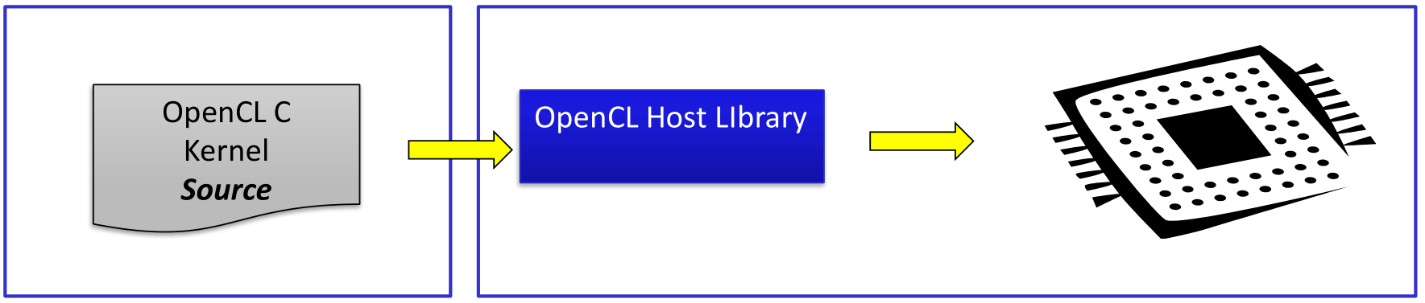
Compilation Flow for source without SPIR
Supports only OpenCL C
ISV is shipping their source code:
  IP risk
© Copyright Khronos Group, 2013

Slide 17
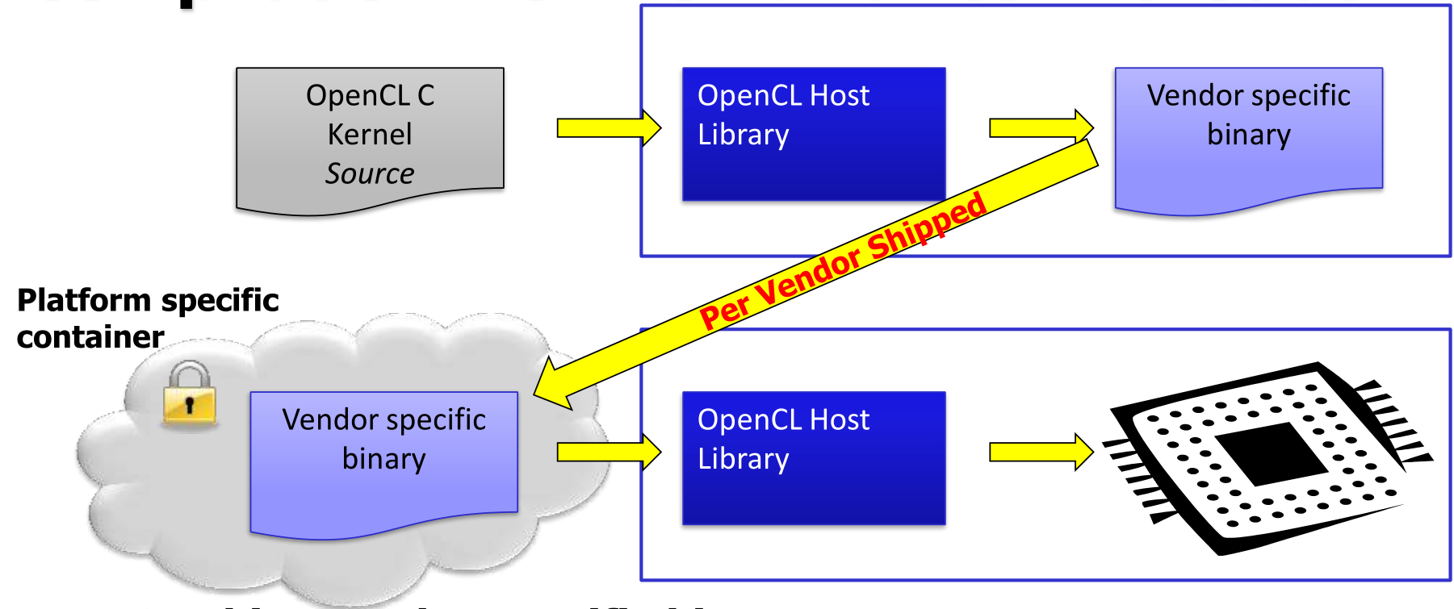
Compilation Flow for binaries without SPIR
ISV ships vendor-specific binary
  Proliferation: devices, driver revisions, vendors
  Market-lagging: target shipped products
© Copyright Khronos Group, 2013

Slide 18
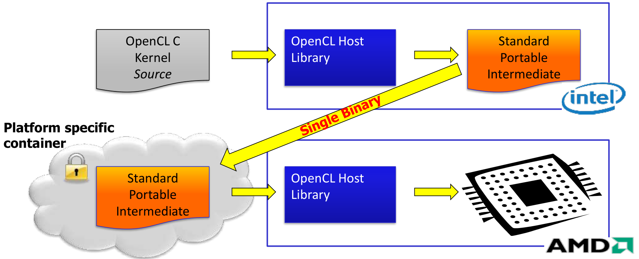
SPIR Binary Compilation Flow
ISV ships kernels in SPIR form
User runs application on vendor of their choice
© Copyright Khronos Group, 2013

Slide 19
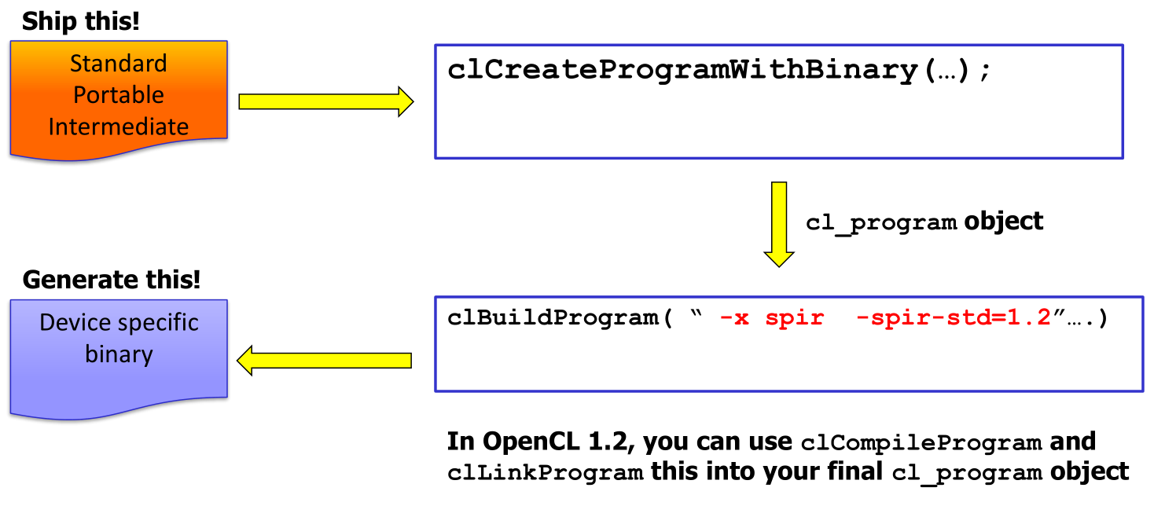
Sample SPIR consumption flow
© Copyright Khronos Group, 2013

Slide 20
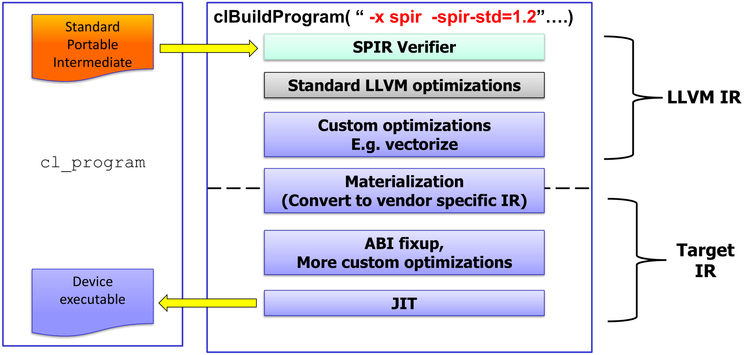
Sample SPIR flow: Room for optimizations
© Copyright Khronos Group, 2013

Slide 21
HSAIL AND SPIR
Feature | HSAIL | SPIR
Intended Users | Compiler developers who want to control their own code generation. | Compiler developers who want a fast path to acceleration across a wide variety of devices.
IR Level | Low-level, just above the machine instruction set | High-level, just below LLVM-IR
Back-end code generation | Thin, fast, robust. | Flexible. Can include many optimizations and compiler transformation including register allocation.
Where are compiler optimizations performed? | Most done in high-level compiler, before HSAIL generation. | Most done in back-end code generator, between SPIR and device machine instruction set

Slide 22
HSAIL AND SPIR
Feature | HSAIL | SPIR
Registers | Fixed-size register pool | Infinite
SSA Form | No | Yes
Binary format | Yes | Yes
Code generator for LLVM | Yes | Yes
Back-end device targets | Modern GPU architectures supported by members of the HSA Foundation | Any OpenCL(tm) device including GPUs, CPUs, FPGAs
Memory Model | Relaxed consistency with acquire/release, barriers, and fine-grained barriers | Flexible. Can support the OpenCL™ 1.2 Memory Model

Slide 23
Ocelot
An Open Source Debugging and Compilation Framework for CUDA

Slide 24
Ocelot Vision
An Open Source Debugging and Compilation Framework for CUDA
  Just-in-time code generation and optimization for CUDA applications
  Basis for a range of productivity and workload characterization tools

Slide 25
Ocelot Vision
CUDA App.
PTX emulation
x86
nvcc
GPU execution
NVIDIA
LLVM Translation
ATI
PTX kernel
Ocelot Infrastructure
NVCC is the CUDA compile driver.

Slide 26
Ocelot PTX Intermediate Representation (IR)
Full-featured PTX IR
  Class hierarchy for PTX instructions/directives
  PTX control flow graph
  Static single-assignment form
  Dataflow/dominance analysis
  Enables PTX optimization
IR to IR translation
  From PTX to other IRs
  LLVM (x86/PowerPC/ARM)
  CAL (AMD GPUs)

Slide 27
PTX -> PTX Optimization
Entry
Entry
Transform
Example: Loop Unrolling
Exit
Exit
Ocelot includes a comprehensive optimization framework for PTX
  Implementation modeled after LLVM passes
  Optimizations can be applied dynamically between kernel executions

Slide 28
Switchable Compute (Ocelot)
Memory allocations
Kernel 1
Switch devices at runtime
  Load balancing
  Instrumentation
  Fault-and-emulate
  Remote execution
switch to cpu
copy
Kernel 2
switch to gpu
copy
Kernel 3

Slide 29
Switchable Compute (HSA)
Memory allocations
Kernel 1
Shared memory architecture reduces the overhead of data copy.
switch to cpu
Kernel 2
switch to gpu
Kernel 3

Slide 30
HSA Translator
HSAIL to x86 Convertor
© Copyright Khronos Group, 2013

Slide 31
HSA Translator
HSAIL(brig) LLVM IR x86
  Brig is the HSAIL binary format.
  In our emulator, brig is Kernel code.
LLVM lib
link
HSA Translator
HSAIL
(brig)
HSA Decoder
LLVM
Optimizer
HSA
Assembler
X86
object file
LLVM IR
LLVM IR
HSA Decoder translates brig file to LLVM IR, and HSA Assembler translates LLVM IR to x86 binary file.

Slide 32
HSA Translator
HSAIL(brig) LLVM IR
LLVM lib
link
HSA Translator
HSAIL
(brig)
HSA Decoder
LLVM
Optimizer
HSA
Assembler
X86
object file
LLVM IR
LLVM IR
HSA Decoder decode the brig file and maps HSAIL instructions to LLVM IR.

Slide 33
HSA Translator
LLVM IR x86
LLVM lib
link
HSA Translator
HSAIL
(brig)
HSA Decoder
LLVM
Optimizer
HSA
Assembler
X86
object file
LLVM IR
LLVM IR
HSA Assembler translates LLVM IR to x86 machine code.
HSA Assembler includes LLVM code generator(backend).

Slide 34
HSA Translator
LLVM IR x86
LLVM lib
link
HSA Translator
HSAIL
(brig)
HSA Decoder
LLVM
Optimizer
HSA
Assembler
X86
object file
LLVM IR
LLVM IR
LLVM code generator(backend) splits the code generation problem into individual passes—instruction selection, register allocation, scheduling, code layout optimization, and assembly emission—and provides many built-in passes that are run by default.

Slide 35
Linker Loader and Helper Function
Linker Loader
X86
object file
Linker &
Loader
Code cache
Helper
function
(memory relative instruction, GPU Kernel information instruction…etc)
In HSAIL, there are some instructions which LLVM IR is not support. We use helper functions to simulate the instructions.
After linking, object codes load in code cache and wait for executing.

